Slide 1
Introduction to NTHU Online judge
Prof. Shun-Ren Yang

Slide 2
NTHU Online Judge
Use NTHU Online Judge for
Homeworks
Labs
Midterms
Final
2

Slide 3
outline
Registration
Find a homework problem
Find a lab/midterm/final contest

Slide 4
outline
Registration
Find a homework problem
Find a lab/midterm/final contest

Slide 5
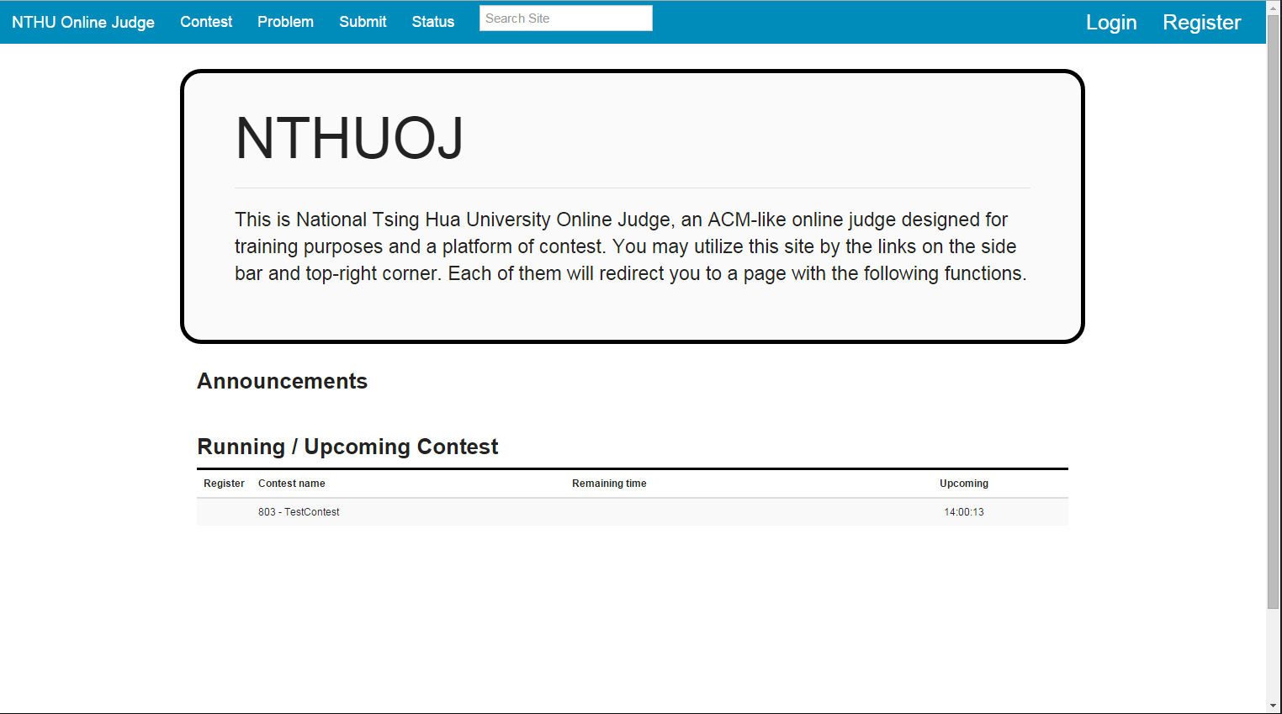
NTHU Online Judge
Website address : 140.114.86.238
5
Notes:
首頁

Slide 6
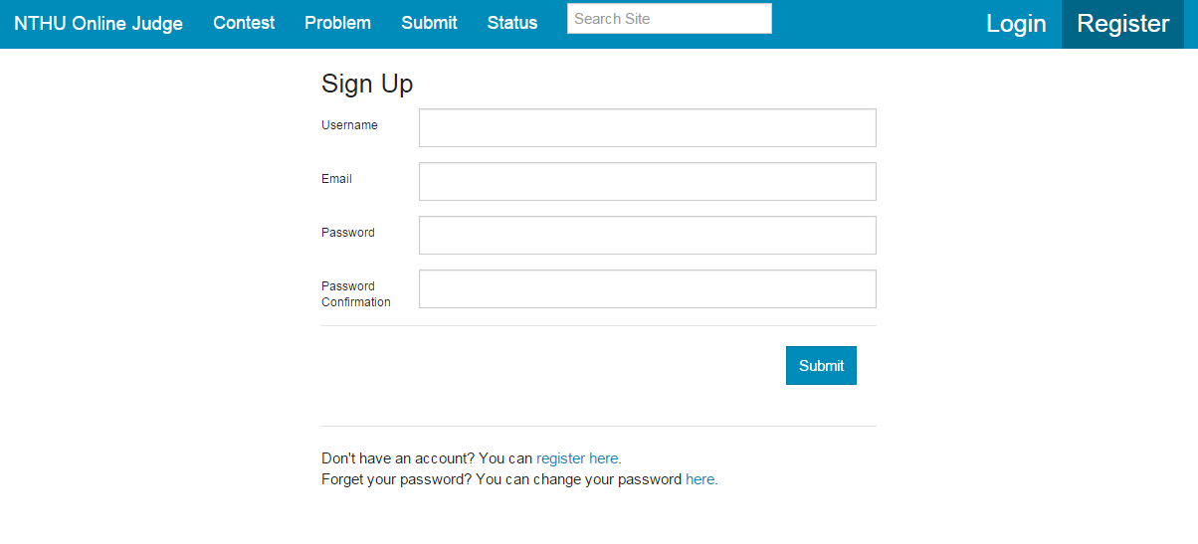
NTHU Online Judge - Register
s + 學號(Student ID)
盡量不要使用yahoo信箱

Slide 7
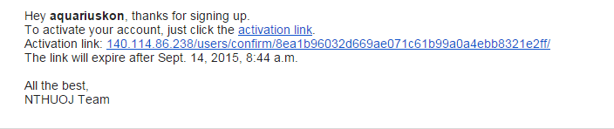
NTHU Online Judge – activation link
到填寫的信箱
收信點選activation link
若無法成功認證,則複製下方網址並在瀏覽器輸入

Slide 8
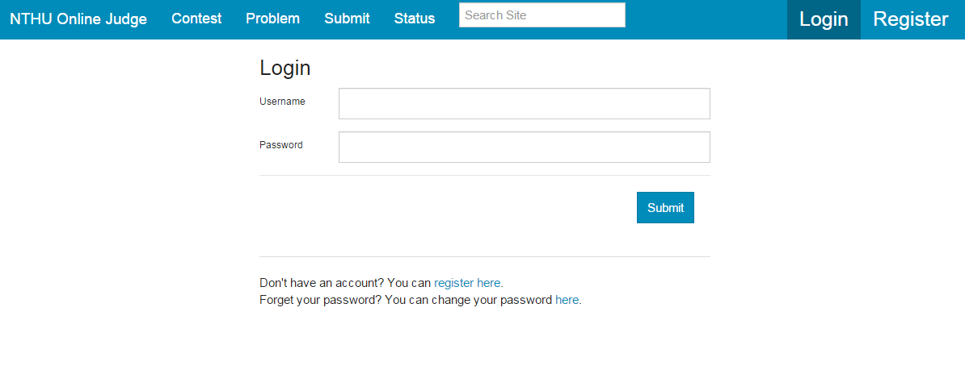
NTHU Online Judge - Login

Slide 9
outline
Registration
Find a homework problem
Find a lab/midterm/final contest

Slide 10
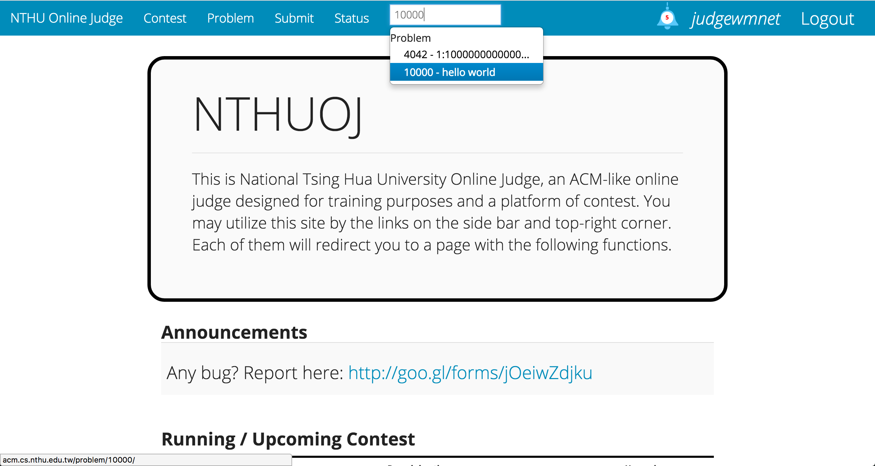
Step 1 – Search Site 10000 – hello world
10

Slide 11
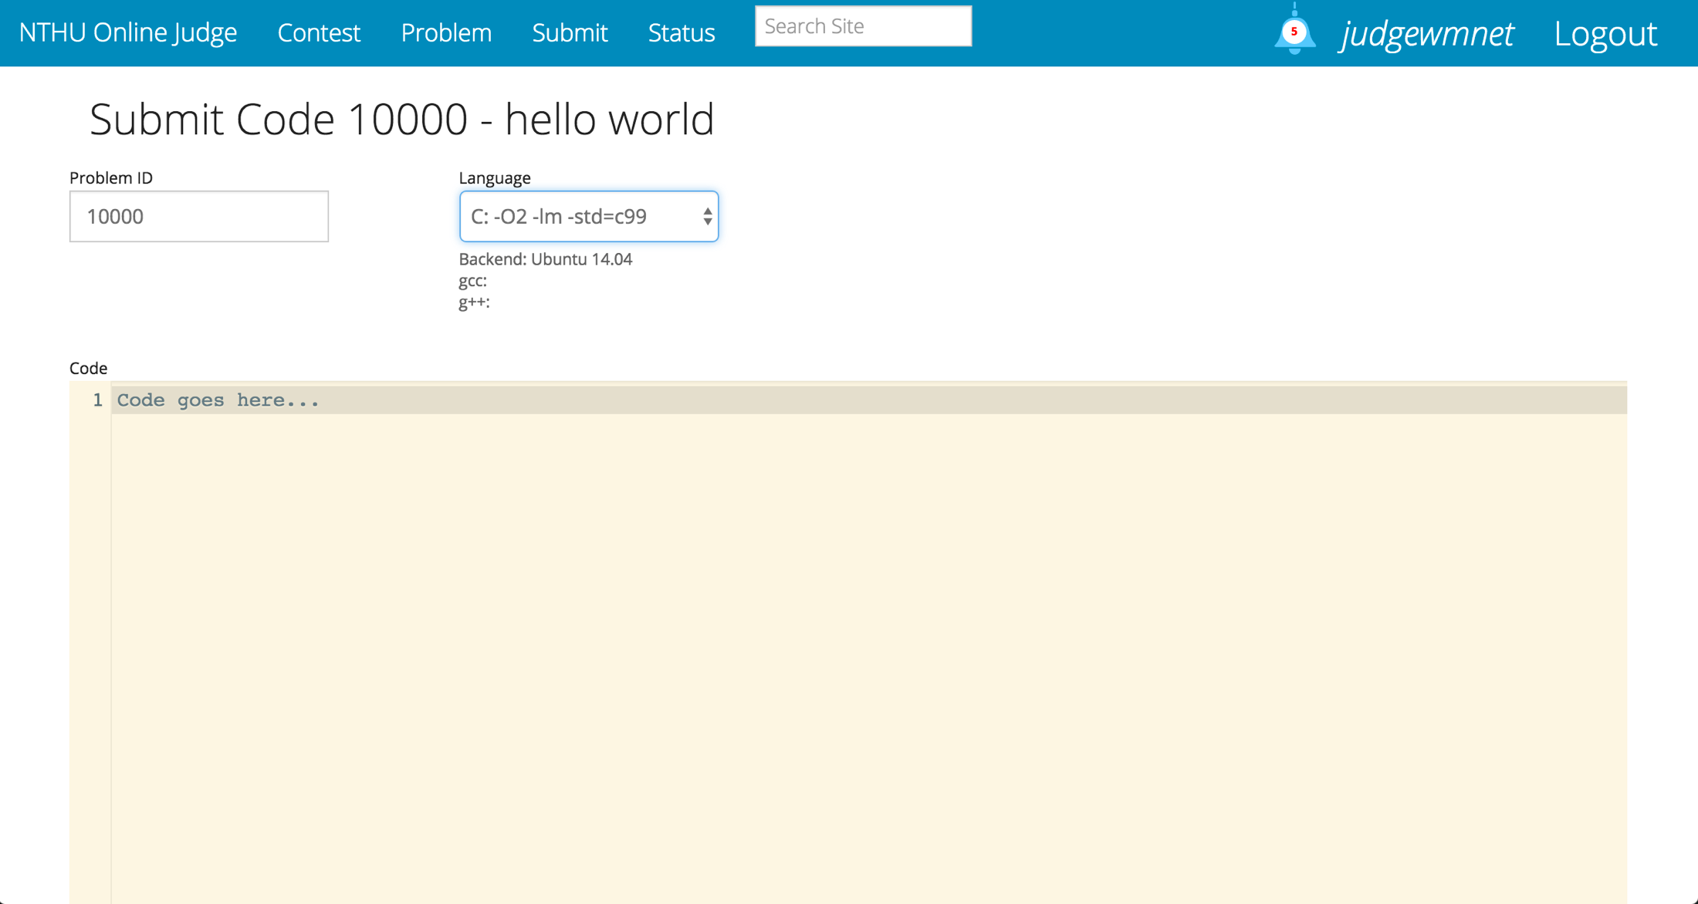
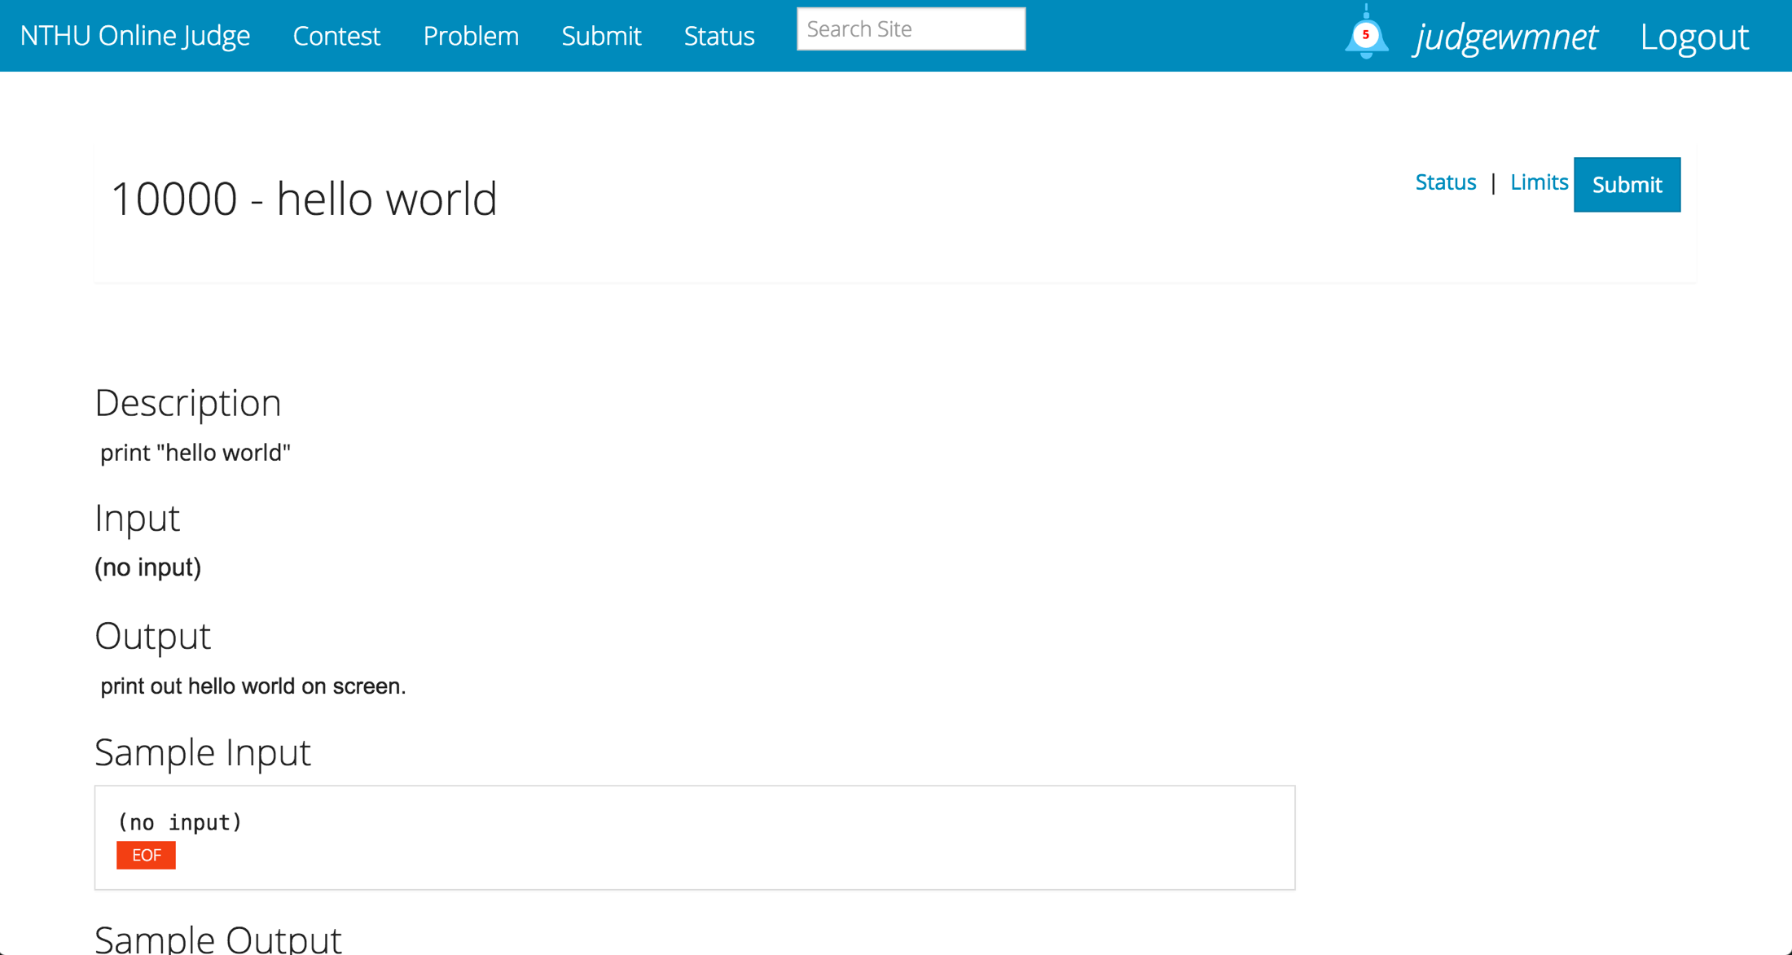
Step 2 – Submit your answer
11

Slide 12
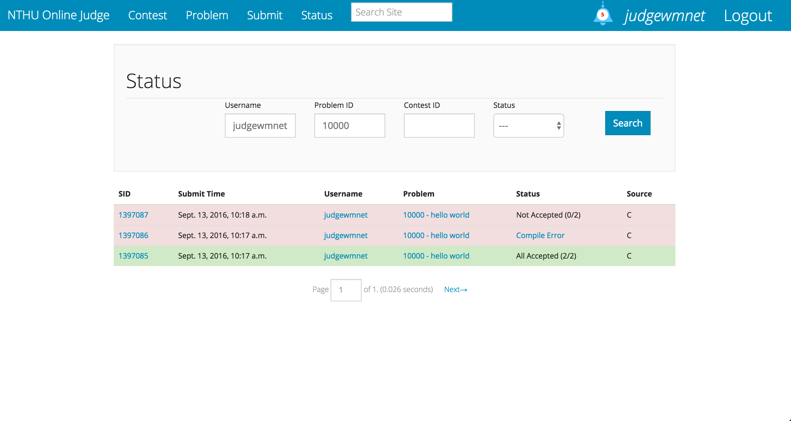
Step 3 – Check result
12

Slide 13
outline
Registration
Find a homework problem
Find a contest in a lab, midterm exam, or final exam

Slide 14
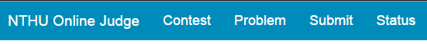
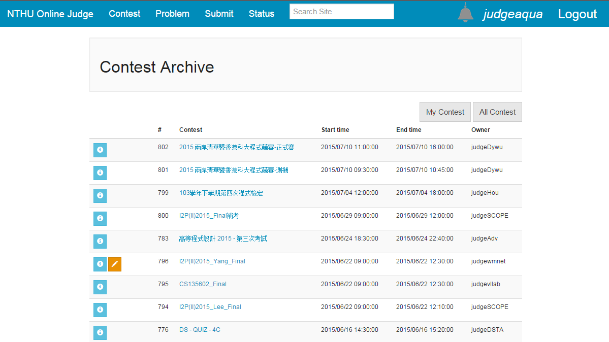
NTHU Online Judge - Contest
14

Slide 15
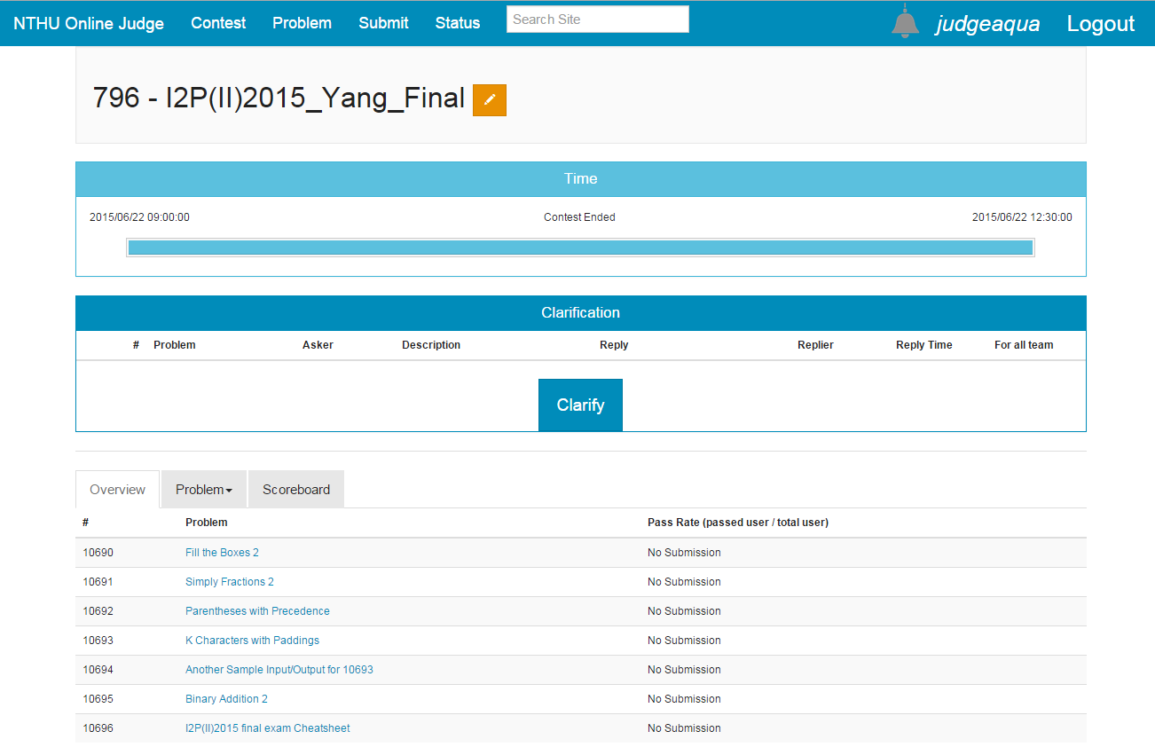
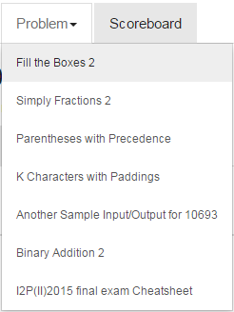

NTHU Online Judge - Overview
15

Slide 16
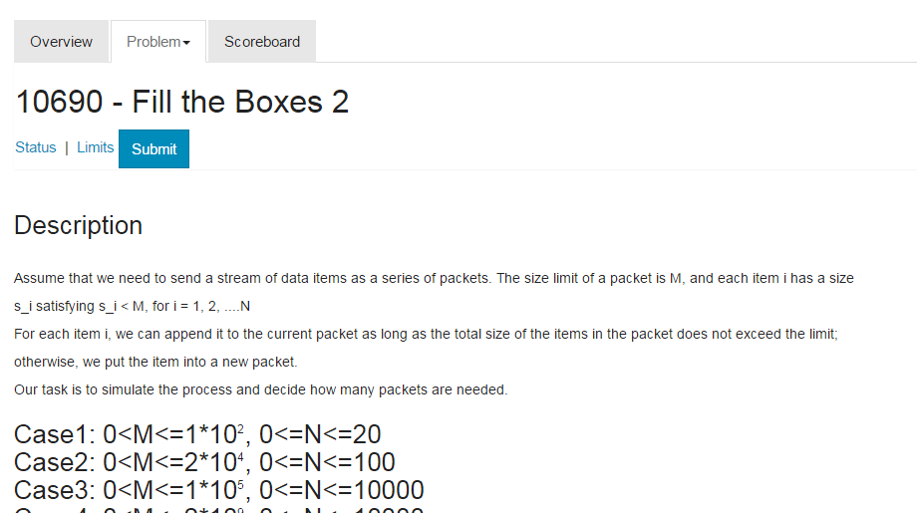
NTHU Online Judge - Problem
Status
Limits
Submit
16

Slide 17
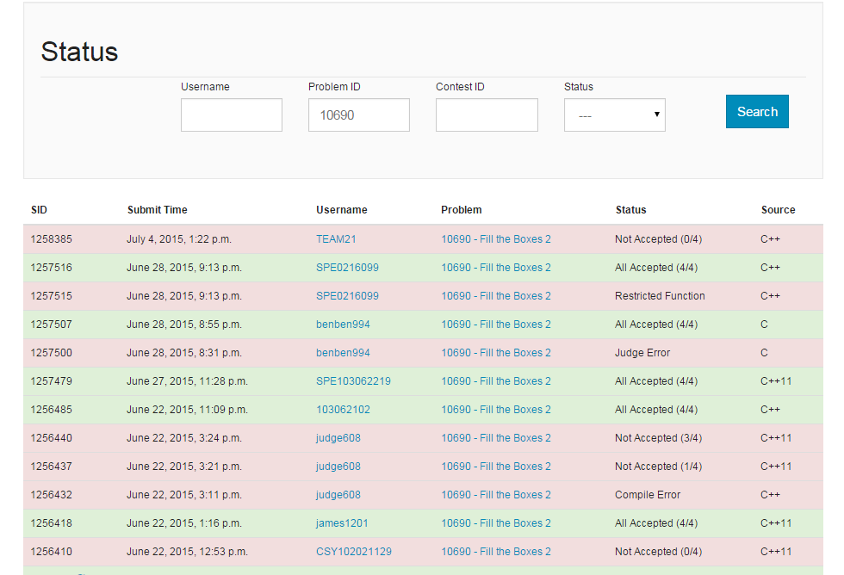
NTHU Online Judge - Status

Slide 18
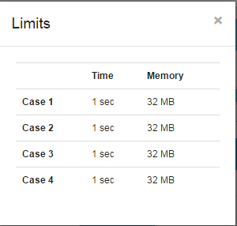
NTHU Online Judge - Limits
18

Slide 19
NTHU Online Judge - Submit
19

Slide 20
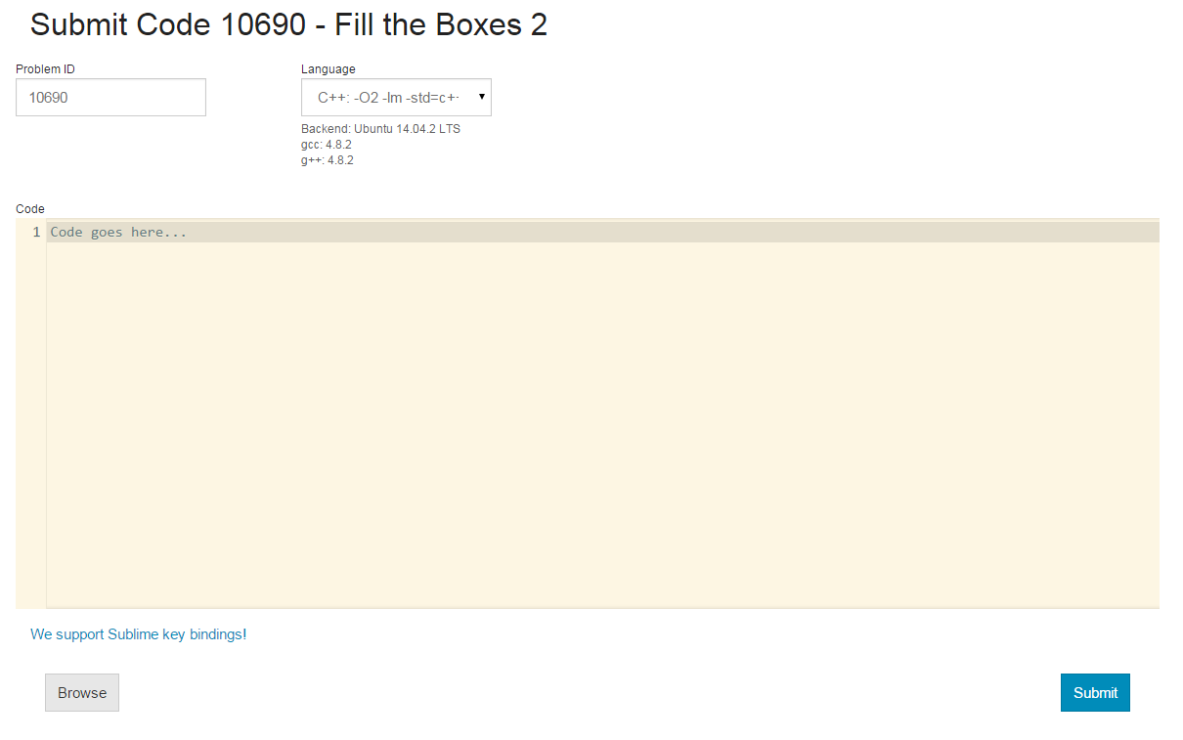

NTHU Online Judge – Submit(2)
這裡貼上你的code

Slide 21
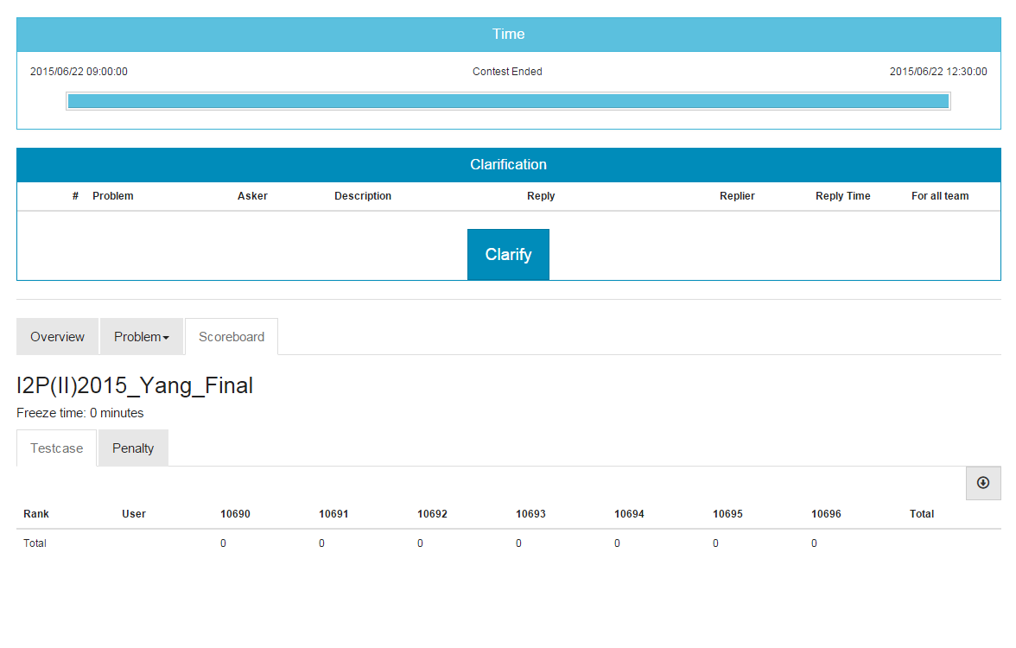
NTHU Online Judge - Scoreboard
21

Slide 22
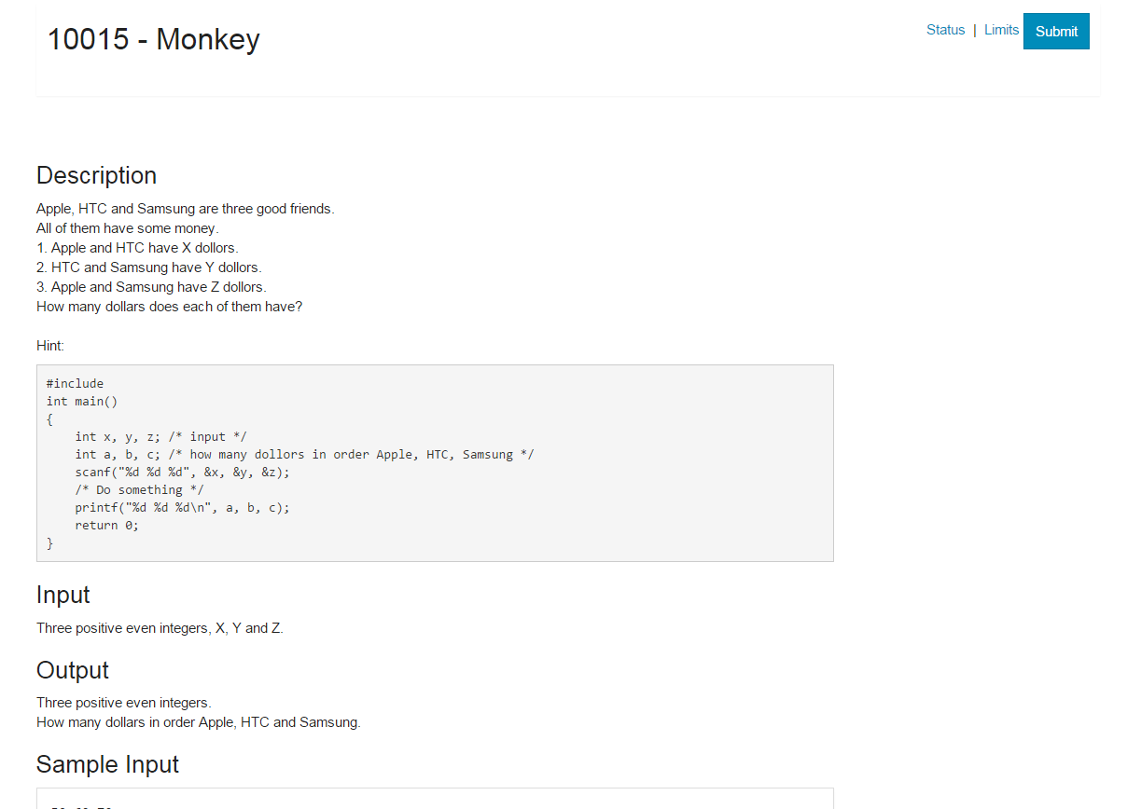
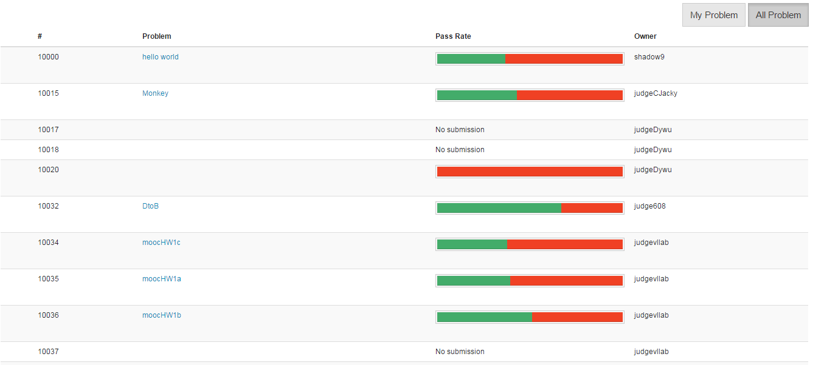
NTHU Online Judge
Problem

Slide 23
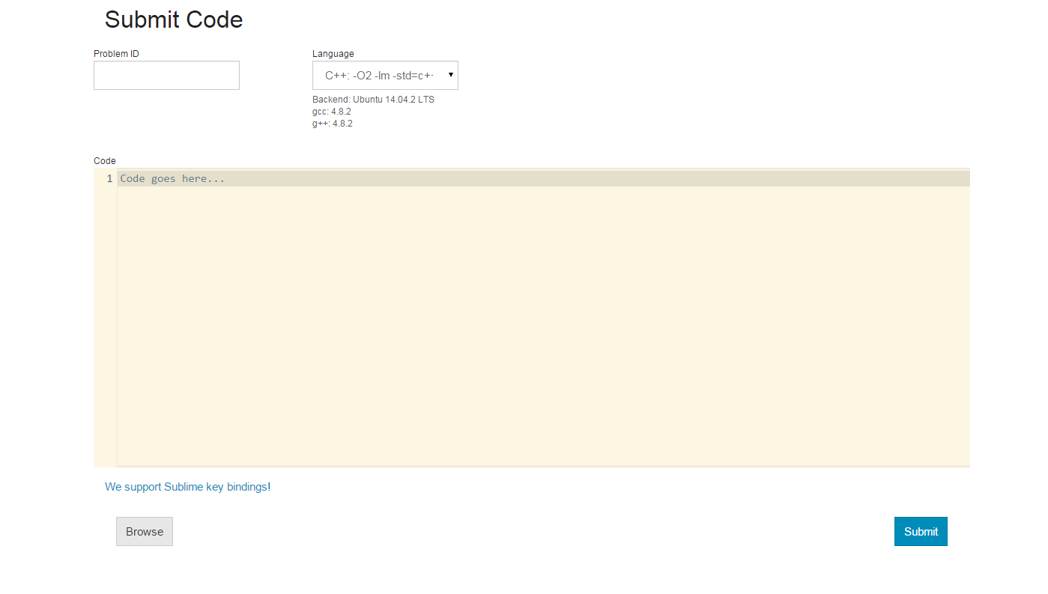
NTHU Online Judge

Slide 24
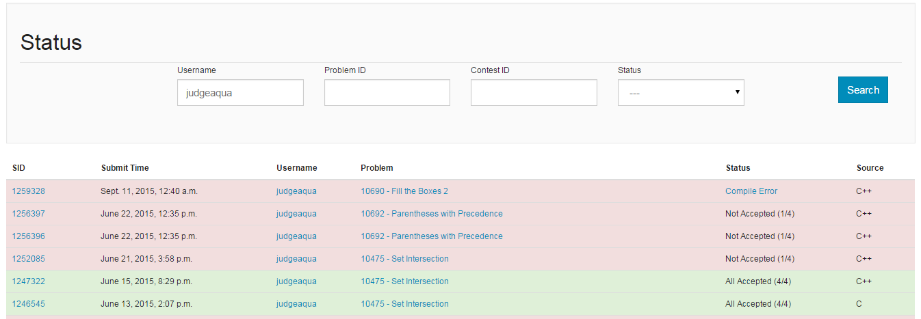
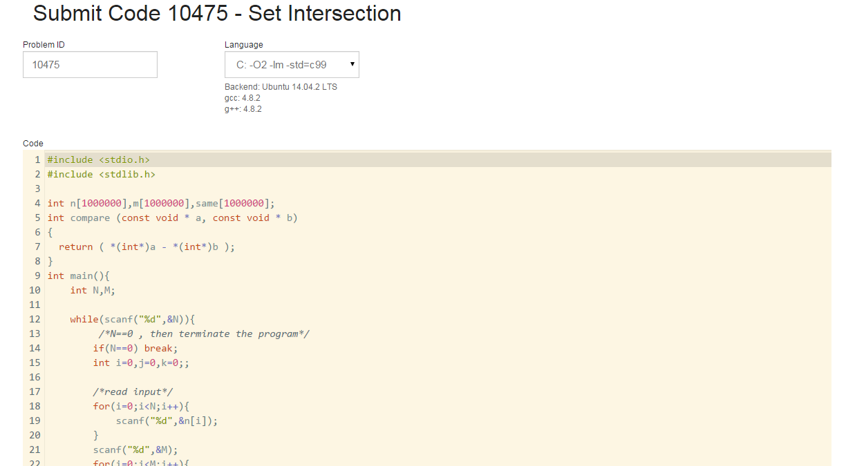
NTHU Online Judge
Status

Slide 25
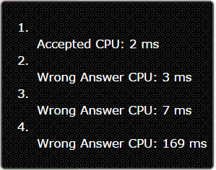
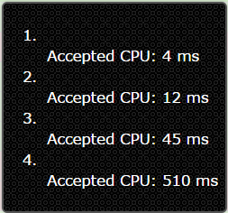
NTHU Online Judge
Status

Slide 26
Submission Result
Accepted (AC)
OK! Your program is correct! It produced the right answer in reasonable time and within the limit memory usage. Congratulations!
Wrong Answer(WA)
Correct solution not reached for the inputs. The inputs and outputs that we use to test the programs are not public so you'll have to spot the bug by yourself.

Slide 27
Submission Result
Presentation Error (PE)
Your program outputs are correct but are not presented in the correct way. Check for spaces,justify, line feeds...
代表output的格式不符合規定，可能要檢查看看有沒有多或少印空格或換行
Runtime Error (RE)
Your program failed during the execution (segmentation fault, floating point exception...).The exact cause is not reported to the user to avoid hacking.

Slide 28
Submission Result
Time Limit Exceed (TL)
Your program tried to run during too much time; this error doesn't allow you to know if your program would reach the correct solution to the problem or not.
Compile Error (CE)
The compiler could not compile your program. Of course, warning messages are not error messages.

Slide 29
Submission Result
Restricted Function (RF)
Your program is trying to use a function that we considered harmful to the system.
Memory Limit Exceeded (ML)
Your program tried to use more memory than the judge allows.

Slide 30
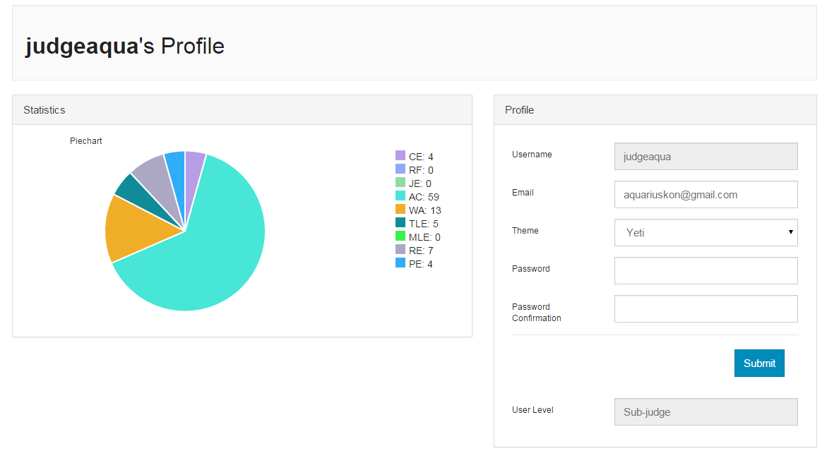

NTHU Online Judge
Profile&Statics

